Slide 1



Innovate UK
Notes:
Show of hands, how many people in the room have already heard of Innovate UK?
Okay, now how many of you have heard of Innovate UK Business Connect? Or the Knowledge Transfer Network?
The UK government publicly funds organisations which directly seek to address this problem, by providing funding, connections, and expertise.
Innovate UK is the government’s innovation agency – but what does that mean?
Innovate UK is the government’s strategic funding service for small and medium businesses. Focused on the government’s strategic priority areas, net zero, healthy living, and digital and technologies, Innovate UK provides grant funding to start and grow businesses that are key to the UK’s growth plan.
And by publicly funded I mean that this support is free, or more accurately, you’ve already paid for it through taxes

Slide 2

Innovate UK
Notes:
Show of hands, how many people in the room have already heard of Innovate UK?
Okay, now how many of you have heard of Innovate UK Business Connect? Or the Knowledge Transfer Network?
The UK government publicly funds organisations which directly seek to address this problem, by providing funding, connections, and expertise.
Innovate UK is the government’s innovation agency – but what does that mean?
Innovate UK is the government’s strategic funding service for small and medium businesses. Focused on the government’s strategic priority areas, net zero, healthy living, and digital and technologies, Innovate UK provides grant funding to start and grow businesses that are key to the UK’s growth plan.
And by publicly funded I mean that this support is free, or more accurately, you’ve already paid for it through taxes

Slide 3

Innovate UK
Notes:
Show of hands, how many people in the room have already heard of Innovate UK?
Okay, now how many of you have heard of Innovate UK Business Connect? Or the Knowledge Transfer Network?
The UK government publicly funds organisations which directly seek to address this problem, by providing funding, connections, and expertise.
Innovate UK is the government’s innovation agency – but what does that mean?
Innovate UK is the government’s strategic funding service for small and medium businesses. Focused on the government’s strategic priority areas, net zero, healthy living, and digital and technologies, Innovate UK provides grant funding to start and grow businesses that are key to the UK’s growth plan.
And by publicly funded I mean that this support is free, or more accurately, you’ve already paid for it through taxes

Slide 4
Innovate UK
Notes:
Show of hands, how many people in the room have already heard of Innovate UK?
Okay, now how many of you have heard of Innovate UK Business Connect? Or the Knowledge Transfer Network?
The UK government publicly funds organisations which directly seek to address this problem, by providing funding, connections, and expertise.
Innovate UK is the government’s innovation agency – but what does that mean?
Innovate UK is the government’s strategic funding service for small and medium businesses. Focused on the government’s strategic priority areas, net zero, healthy living, and digital and technologies, Innovate UK provides grant funding to start and grow businesses that are key to the UK’s growth plan.
And by publicly funded I mean that this support is free, or more accurately, you’ve already paid for it through taxes

Slide 5
Innovate UK
Innovate UK Business Connect
Innovate UK Business Growth
Catapult Centres

Slide 6
Innovate UK
Innovate UK Business Connect
Innovate UK Business Growth
Catapult Centres
Notes:
The UK government publicly funds organisations which directly seek to address this problem, by providing funding, connections, and expertise.
Innovate UK is the government’s innovation agency – but what does that mean?
Innovate UK is the government’s strategic funding service for small and medium businesses. Focused on the government’s strategic priority areas, following the Industrial Strategy, Innovate UK provides grant funding to start and grow businesses that are key to the UK’s growth plan.
And by publicly funded I mean that this support is free, or more accurately, you’ve already paid for it through taxes

Slide 7
Innovate UK
Innovate UK Business Connect
Innovate UK Business Growth
Catapult Centres
Notes:
Show of hands, how many people in the room have already heard of Innovate UK?
Okay, now how many of you have heard of Innovate UK Business Connect? Or the Knowledge Transfer Network?
The UK government publicly funds organisations which directly seek to address this problem, by providing funding, connections, and expertise.
Innovate UK is the government’s innovation agency – but what does that mean?
Innovate UK is the government’s strategic funding service for small and medium businesses. Focused on the government’s strategic priority areas, net zero, healthy living, and digital and technologies, Innovate UK provides grant funding to start and grow businesses that are key to the UK’s growth plan.
And by publicly funded I mean that this support is free, or more accurately, you’ve already paid for it through taxes

Slide 8
Innovate UK
Innovate UK Business Connect
Innovate UK Business Growth
Catapult Centres
Notes:
Show of hands, how many people in the room have already heard of Innovate UK?
Okay, now how many of you have heard of Innovate UK Business Connect? Or the Knowledge Transfer Network?
The UK government publicly funds organisations which directly seek to address this problem, by providing funding, connections, and expertise.
Innovate UK is the government’s innovation agency – but what does that mean?
Innovate UK is the government’s strategic funding service for small and medium businesses. Focused on the government’s strategic priority areas, net zero, healthy living, and digital and technologies, Innovate UK provides grant funding to start and grow businesses that are key to the UK’s growth plan.
And by publicly funded I mean that this support is free, or more accurately, you’ve already paid for it through taxes

Slide 9



Compound Semiconductor
Energy Systems
Offshore Renewable Energy
Medicines Discovery
Cell and Gene Therapy
High Value
Manufacturing
Satellite Applications
Connected Places
Digital Catapult
Notes:
Innovate UK established 9 catapult centres
These provide expertise, facilities, equipment, and sometimes funding to support business innovation and growth in these sectors
The catapult centres are not for profit technology and innovation centres
Their purpose is to help businesses turn research into commercial products and services
They do this by providing facilities, expertise, testing and industry links

Slide 10
Innovate UK
Innovate UK Business Connect
Innovate UK Business Growth
Catapult Centres
Notes:
Do not provide funding
Offer support to pre-incorporated, new and existing innovative businesses
Provide advice on grant application
Offer introductions to collaborative research partners
Can help in identifying alternative sources of funding or networking events

Slide 11
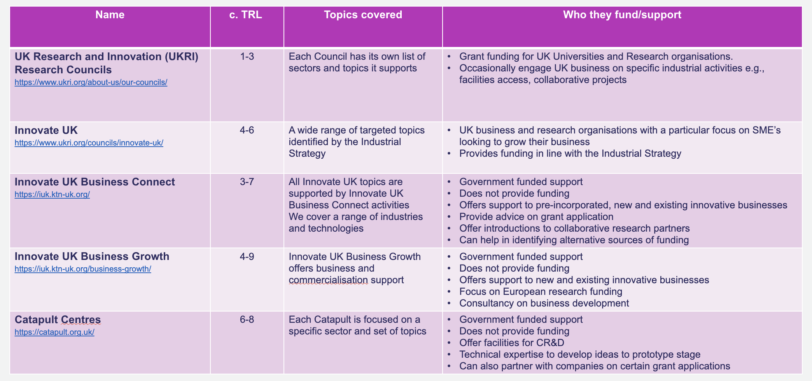
Notes:
Do not provide funding
Offer support to pre-incorporated, new and existing innovative businesses
Provide advice on grant application
Offer introductions to collaborative research partners
Can help in identifying alternative sources of funding or networking events

Slide 12

A strong regional presence
From funding and advisory services to facility and technology access, Innovate UK and our partners offer innovation support to businesses everywhere in the UK.
The geographical distribution of our staff and facilities ensures we engage place-based stakeholders and meet the needs of the regions and nations of the UK.
Regional Managers, Partners, Offices and KTAs
Innovate UK Catapult Network
UK Agri-Tech Centre
Notes:
Innovate UK, Business Connect, Business Growth and the Catapults and my colleagues
Are based throughout the UK
So Grace is based near the lake district, I’m based near Leeds, and we have colleagues based up north, down south, and everywhere in between
We provide support by connecting academics and businesses throughout the country, and will always take any opportunity to visit a business or a lab in person where we can
This helps us to understand what innovations are going on in our sectors
And to better understand the challenges and opportunities

Slide 13

Understanding how we help
Overview
We support innovators to deliver their technology & connect for positive change
FAQ around our support - https://iuk-business-connect.org.uk/how-we-help/
People
Products
Pounds
Notes:
To summarise the examples
they’re different in scale, sector, and outcome
but they all show the same underlying role
Innovate UK Business Connect acts as a matching function
connecting innovators to the right people
the right insight
and the right opportunities
The value is not one programme or one intervention
it’s reducing misalignment
between technology stage and opportunity
between product and market need
between academics and the networks that can move things forward
Across all the examples
involvement happened before a route was fixed
when there was still flexibility
and when timing really mattered
So if you take one thing from this section
it’s this simple rule of thumb
When one of your academics is at a point where
people
products
or pounds
are the dominant questions
and the answers aren’t yet clear
That is often a very good moment to loop us in
Not to prescribe a path
but to help ensure they’re in
the right place
at the right time
with the right product

Slide 14
When we can help
You might consider looping us in when:
A technology aligns with Industrial Strategy priority areas
The commercial route is still open (spin-out, licensing, collaboration)
Funding or scale-up pathways are unclear or fast-moving
Industry connections would help shape direction
Funding from grants or accelerators would have benefit
Wider visibility of opportunities
People
Products
Pounds
Notes:
uilding on the examples, I want to make this very practical
These are not rules
They’re signals we see repeatedly where early engagement adds value
One signal is when a technology aligns with Industrial Strategy priority areas
These are often fast-moving spaces
With multiple programmes, partnerships, and funding routes emerging
Early visibility can materially change what options are available
Another is when the commercial route is still open
Spin-out
Licensing
Collaboration
Or something else
This is where additional perspective and networks can help shape direction before anything is fixed
A third signal is when funding or scale-up pathways feel unclear or fast-moving
Short call windows
Multiple possible routes
Or uncertainty about what fits the stage
Early conversations help sense-check timing and suitability
We’re also useful when industry connections would shape the product or proposition
Technical partners
End-users
Sector specialists
Regulatory or adoption insight
Especially where feedback could change how the technology is positioned
And finally, when private investment or accelerators are being discussed
Not because they’re always the right answer
But because understanding what’s emerging, and what’s realistic, is easier with early context
So if you leave with a simple mental checklist
People
Products
Pounds
When one or more of those is the dominant question
and the answer isn’t yet clear
that’s often a good moment to involve us
The aim here is not to add process
it’s to widen options
and improve matching

Slide 15

Email
Jessica.Dobson@iukbc.org.uk
LinkedIn
www.linkedin.com/in/drjadobson
https://www.linkedin.com/company/innovateukbusinessconnect
People
Products
Pounds

