Slide 1
Bioresource Opportunities in the UK
Sophie Mason – Senior Consultant
21th April 2026

Slide 2





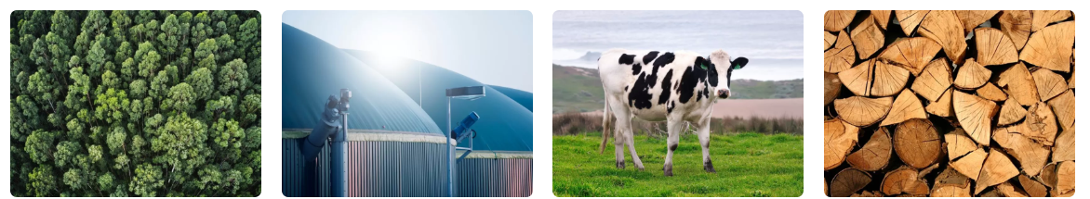
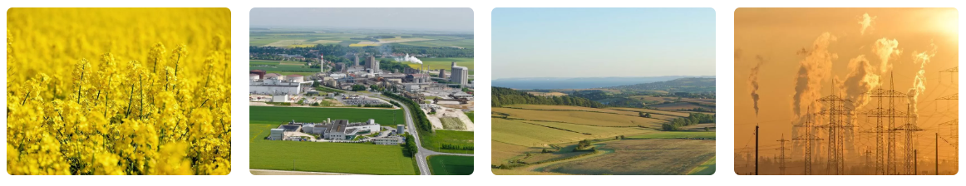
Alder BioInsights
A specialist strategic business consultancy with over 20 years of bioeconomy experience
Notes:
Alder are feedstock experts – it underpins everything we do.

Slide 3
  to provide sector leading strategic business consultancy; analysing, explaining and de-risking the bioeconomy for our clients.
Mission
  to provide clients with a strategic view of feedstock, technology, policy and market development across the bioeconomy, enabling them to make informed business decisions and develop sustainable business strategies.
Objective

Slide 4
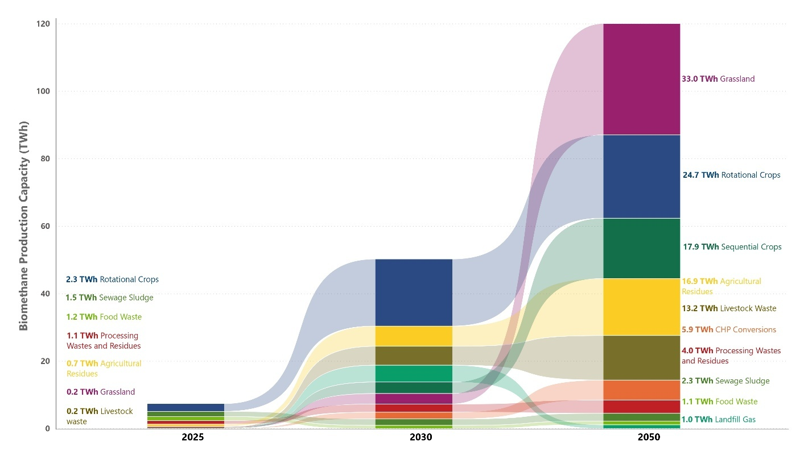

Sustainable Biomethane Potential
Potential future availability of different biomass feedstocks in the UK, by 2030 and 2050.
Source: Green Gas Taskforce (2025). A Green Gas Future: Outlining the feedstock potential for biomethane generation.
Notes:
This project follows on from previous project for GGT on biomethane potential in the UK
Which said ~120 TWh of biomethane production in the UK before 2050
Demonstrating that biomethane and AD is critical to decarbonising UK energy – and achieving net zero

Slide 5
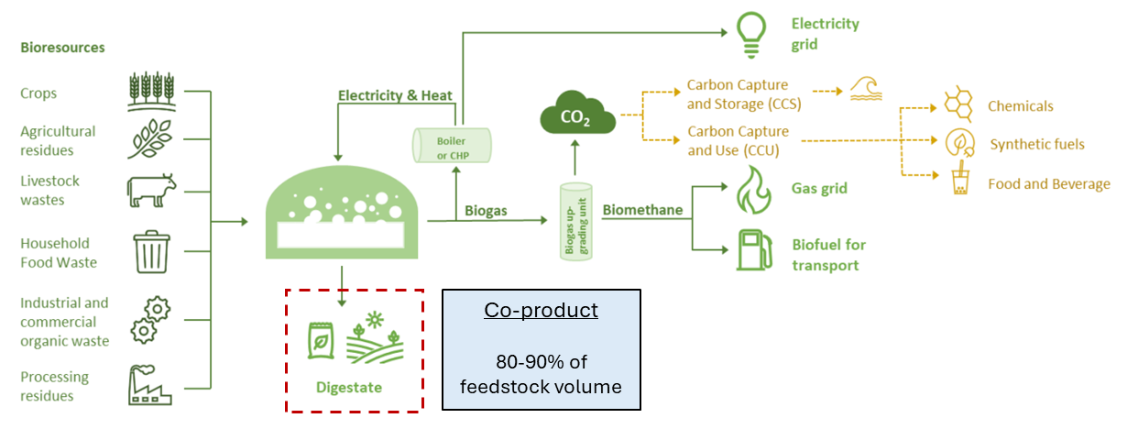
The AD process
more biomethane = more digestate
Notes:
Digestate always traditionally seen as a problem to be dealt with – an after thought

Slide 6
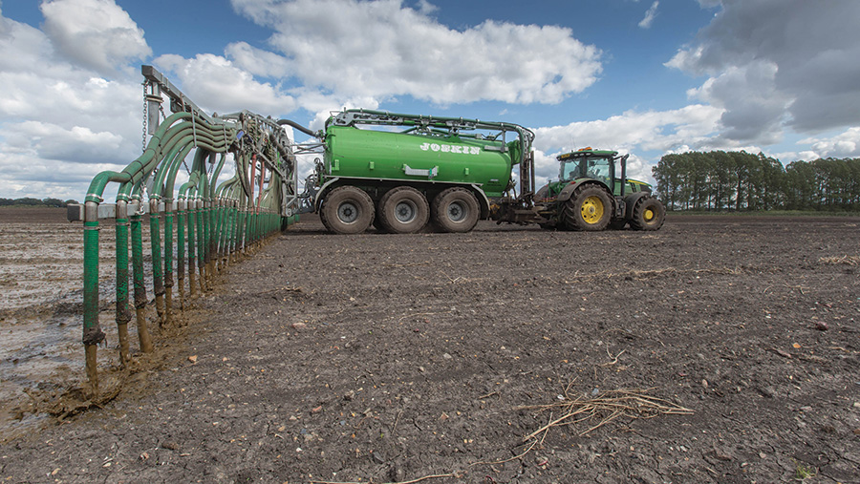
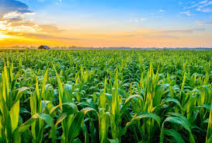
Digestate Properties
Digestate composition can vary depending on the types of feedstocks fed into the anaerobic digester, but also on the type of digester used, or even between batches from the same digester.
However, in general, digestates contain a range of plant-derived nutrients (both macro and micronutrients) and heavy metals.
  Macronutrients: nitrogen (N), phosphorous (P), potassium (K), calcium (Ca), magnesium (Mg), and sulphur (S)
  Micronutrients: boron (B), cobalt (Co), copper (Cu), chlorine (Cl), iron (Fe), manganese (Mn), molybdenum (Mo), nickel (Ni), selenium (Se), and Zinc (Zn)
  Heavy metals: lead (Pb), chromium (Cr), cadmium (Cd), and Mercury (Hg)
All nutrients present in the original feedstocks remain in digestate post-digestion.
Given the nutrient content of digestate, it is primarily used as a fertiliser in agricultural applications.
Notes:
Benefits – a fantastic source of nutrients
Composition will vary depending on the feedstocks use – this is something that we will be looking at as part of the project – with the aim of understanding how different types of digestate can be best used

Slide 7
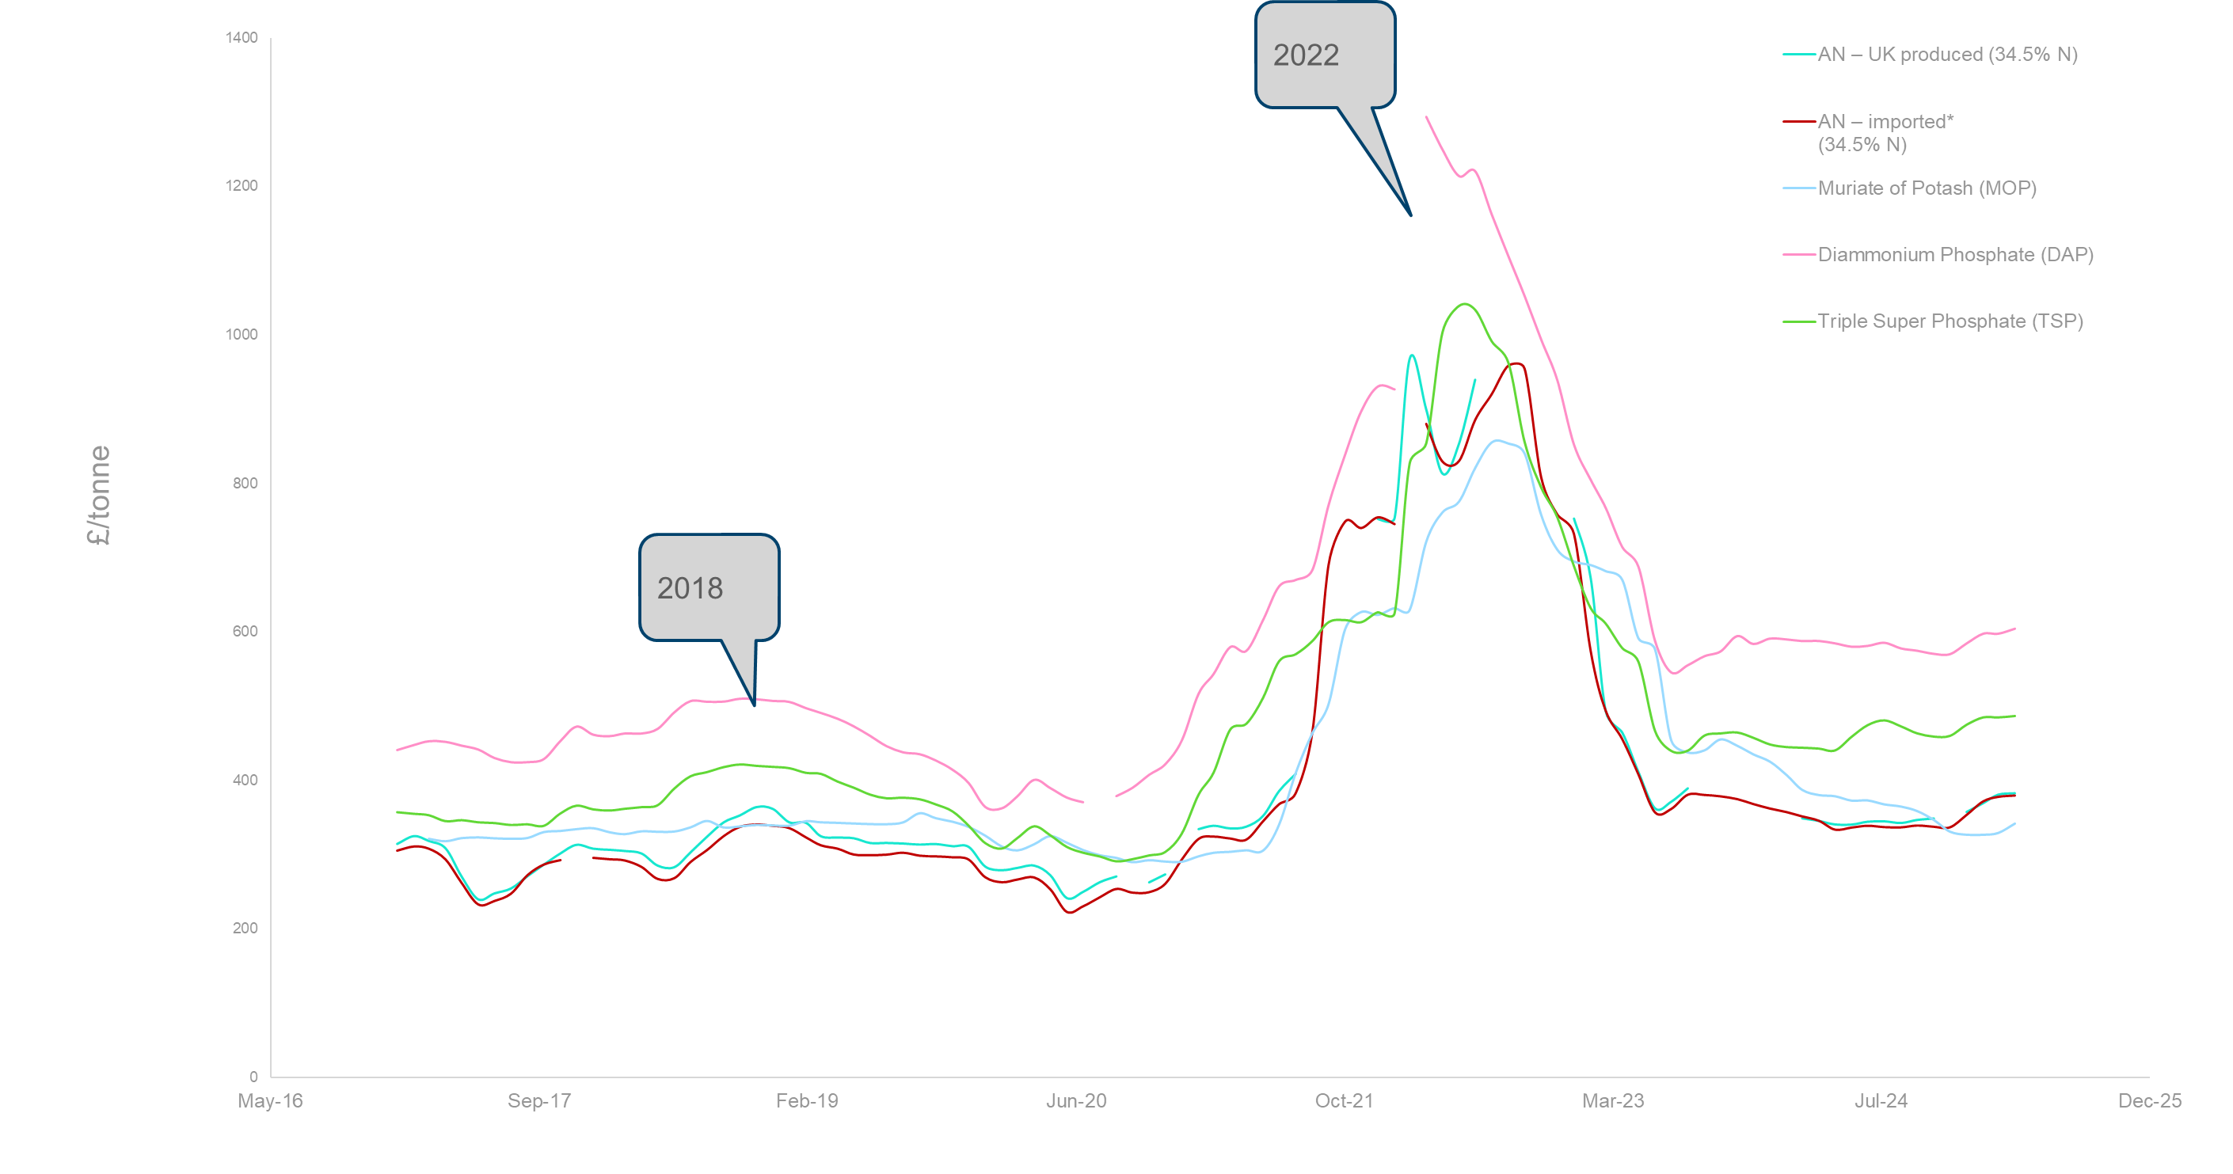
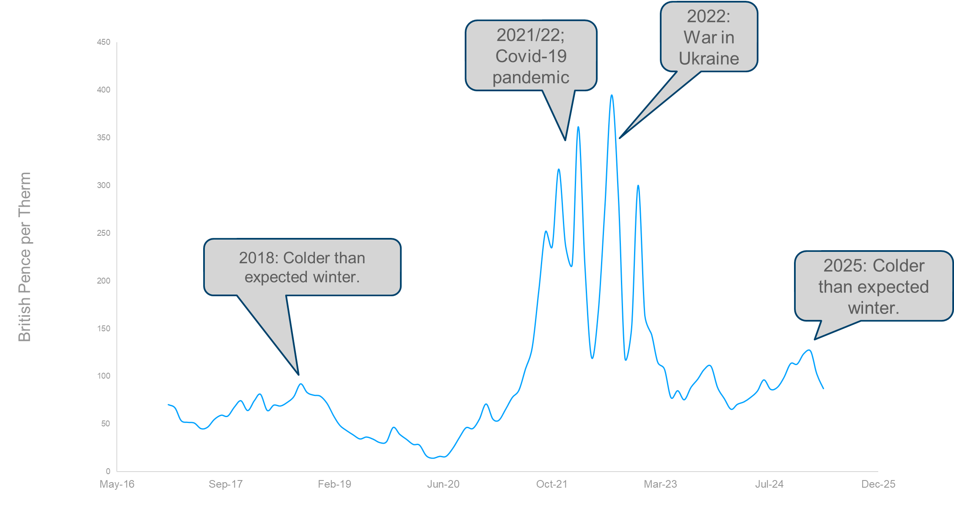
Digestate as a Fertiliser
The economic & resource security consideration
Digestate is an organic replacement for synthetically produced fertilisers.
Notes:
Price volatility – impact on farmers and in food prices
No domestic supply – resource security
Carbon Border adjustment mechanism

Slide 8
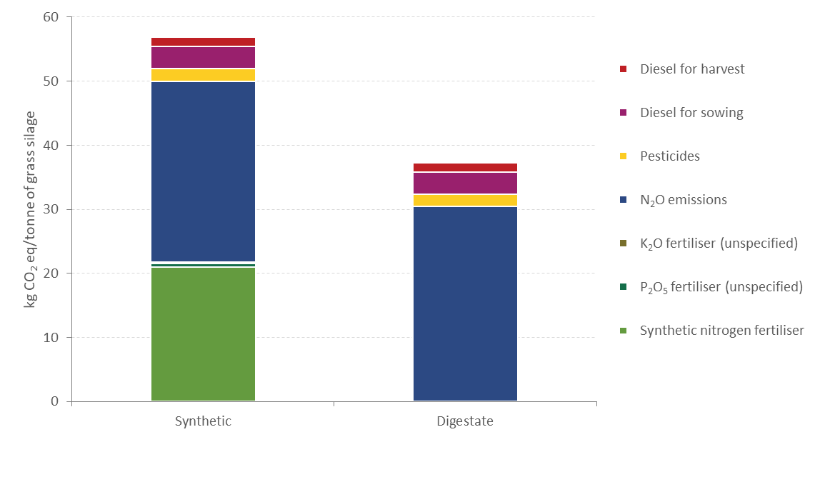
Digestate as a fertiliser
The environmental consideration
It is estimated that the replacement of 1 tonne of artificial fertiliser with digestate will save up to:
- 1 tonne of crude oil,
- 108 tonnes of water, and
- 7 tonnes of CO₂ (eq) emissions.
Comparative emissions associated with the production of 1 tonne of grass silage, using only synthetic fertiliser compared to using only digestate.
Notes:
As well as the economic impact – environmental impact of digestate is also important to highlight
While we do not know which way the future policy framework will go – if the AD sector is pushed towards lowering the carbon intensity of the biomethane they produce – the use of digestate to grow crop feedstocks will make a real difference compared to synthetic alternatives
In this example – the use of synthetic fertilisers accounts for ~1/3 of the GHG associated with the Grass silage crop grown for AD.

Slide 9
Digestate Challenges
Alder helps sites to navigate challenges associated with digestate, including:
  Offtake demand – is it produced close to where it is needed?
  Logistical requirements – storage/transport
  Landbank availability – is there enough suitable land to spread digestate?
  Weather/climate – digestate cannot be used if the weather is poor
  Nutrient management – need to be careful not to damage soils with nutrient mismanagement
With proper planning and management many of these issue can be foreseen and dealt with.
Some of these issues could also be dealt with via technology developments, but technology options not widespread or commercially viable in many cases.
Alder’s work will inform on areas where government support could be beneficial to the sector, to drive industry growth in this area.
Notes:
Digestate hierarchy of use
Hub and spoke model
Just wanted to end by saying that this is just a very small segment of the bioeconomy – and many opportunities and challenges face similar materials - but its an exciting area to work in, especially when you consider what’s going on in the world and how the bioeconomy could help us as a society instead.

Slide 10
Thank you!
s.mason@alderbioinsights.co.uk

